Slide 1
Pizza People Mad Dog Program
Notes:
Hi everyone! Welcome to the Pizza People Mad Dog Program breakout. During our time in this session we’re going to discuss how to recognize a Mad Dog when you see them, how to best utilize this person to build sales, and also how to measure the success of their local store marketing efforts. In this breakout, I will provide you with a basic outline as to how to structure your store’s personal Mad Dog marketing program and how to manage those involved.

Slide 2
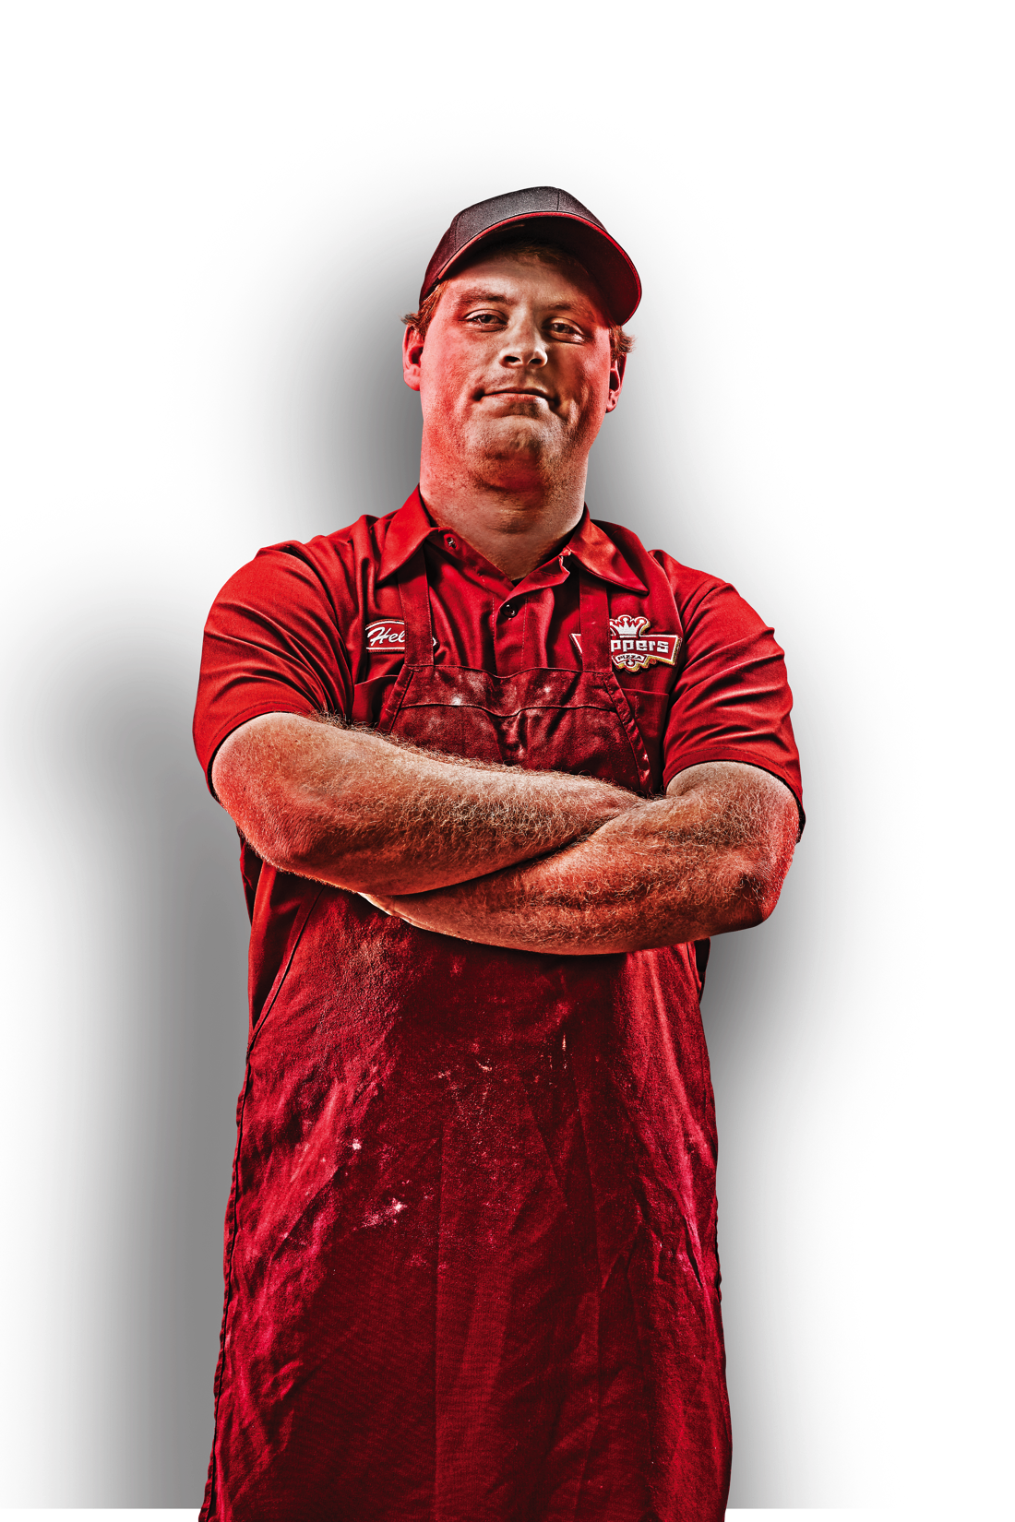
Select Mad Dog(s)
Defined as: a Team Member designated or hired specifically to plan and execute local store marketing (LSM)
Organized
Reliable
Outgoing and Knowledgeable
Recognize and act on marketing opportunities
1-5 stores
5-10 hours/week per store
Notes:
What even is a ‘Mad Dog?’
Someone who gets outside of the store and really dominates trade areas in terms of local store marketing.
To put it simply: a team member designated or hired specifically to plan and execute local store marketing (LSM)
Must be: organized, reliable, outgoing and enthusiastic, knowledgeable about Toppers products and promotions, able to recognize marketing opportunities and act accordingly
1-5 stores
5-10 hours/ week per store

Slide 3
Type of store
Campus vs. Residential
Type of market
Familiar vs. Unfamiliar
Define
objectives and
set goals
Current LSM being executed
New Customer / Late Cards, Business of the Week, Door hanging, hotel visits, pizza demos, etc.
Programs being executed well or regularly
Extra training on those not being executed well or regularly
Which Programs would you like to start executing?
Notes:
Once a Mad Dog is selected or hired, the next step is to define your LSM objectives and set goals for sales building. Basically, you need to establish a clear starting point with your Mad Dog so that they know what’s expected of them.
It is recommended to give this some thought on your own, then schedule about an hour long meeting with your Mad Dog to discuss things further and see what ideas they bring to the table.
The following list contains recommended items to discuss when having your initial meetings with general managers and their Mad Dogs.

Slide 4
Additional marketing opportunities
Larger businesses or neighborhoods not ordering regularly
Festivals and Events
Schools or Organizations for Dough-Nation Nights
Sales Goals
Increase sales by ___ % in ___ weeks
Set record week
Define
objectives and
set goals
Staffing goals
Need to have adequate staff to handle extra sales coming in from LSM

Slide 5
Toppers Marekting Resource Center– Marketing Essentials
https://b2b.suttle-straus.com/C/toppers/customer/account/login/
Notes:
https://b2b.suttle-straus.com/C/toppers/customer/account/login/
After you and your Mad Dog establish goals, it’s a good idea to take them on a tour of the Marketing Resource Center (MRC), where you can find almost everything you need to execute some quality local store marketing.

Slide 6
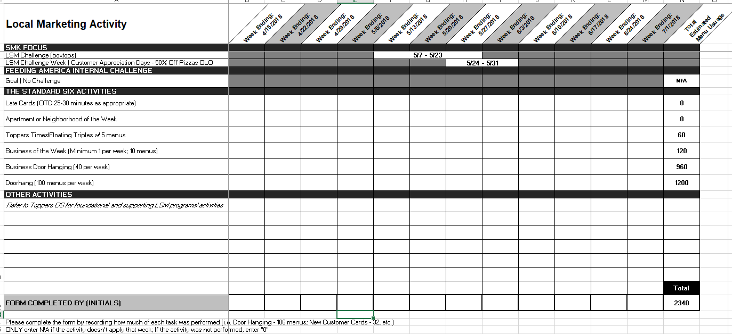
Create LSM Checklist
Notes:
A great asset for organization is the LSM checklist, which can be found in the MIT Program in the Brand level, and is also updated each SMK.
This checklist should be personalized to fit your store’s LSM tasks and goals- the ones that you established earlier. Ideally, this checklist should be filled out by the Mad Dog when tasks are completed and then handed in weekly to the program runner (GM or Zee) for review.
Other things to consider- creating and activating program buttons on the POS (BOW/AOW/NOW, Hotel program buttons, etc.) If there is a special limited time only offer you’re wanting to do, connect with IT to make sure the code is programed on the Website end of things, as well as with Abbey Watson, our Graphic Design Manager so she can help you with any flyer needs for promotion. awatson@toppers.com.

Slide 7
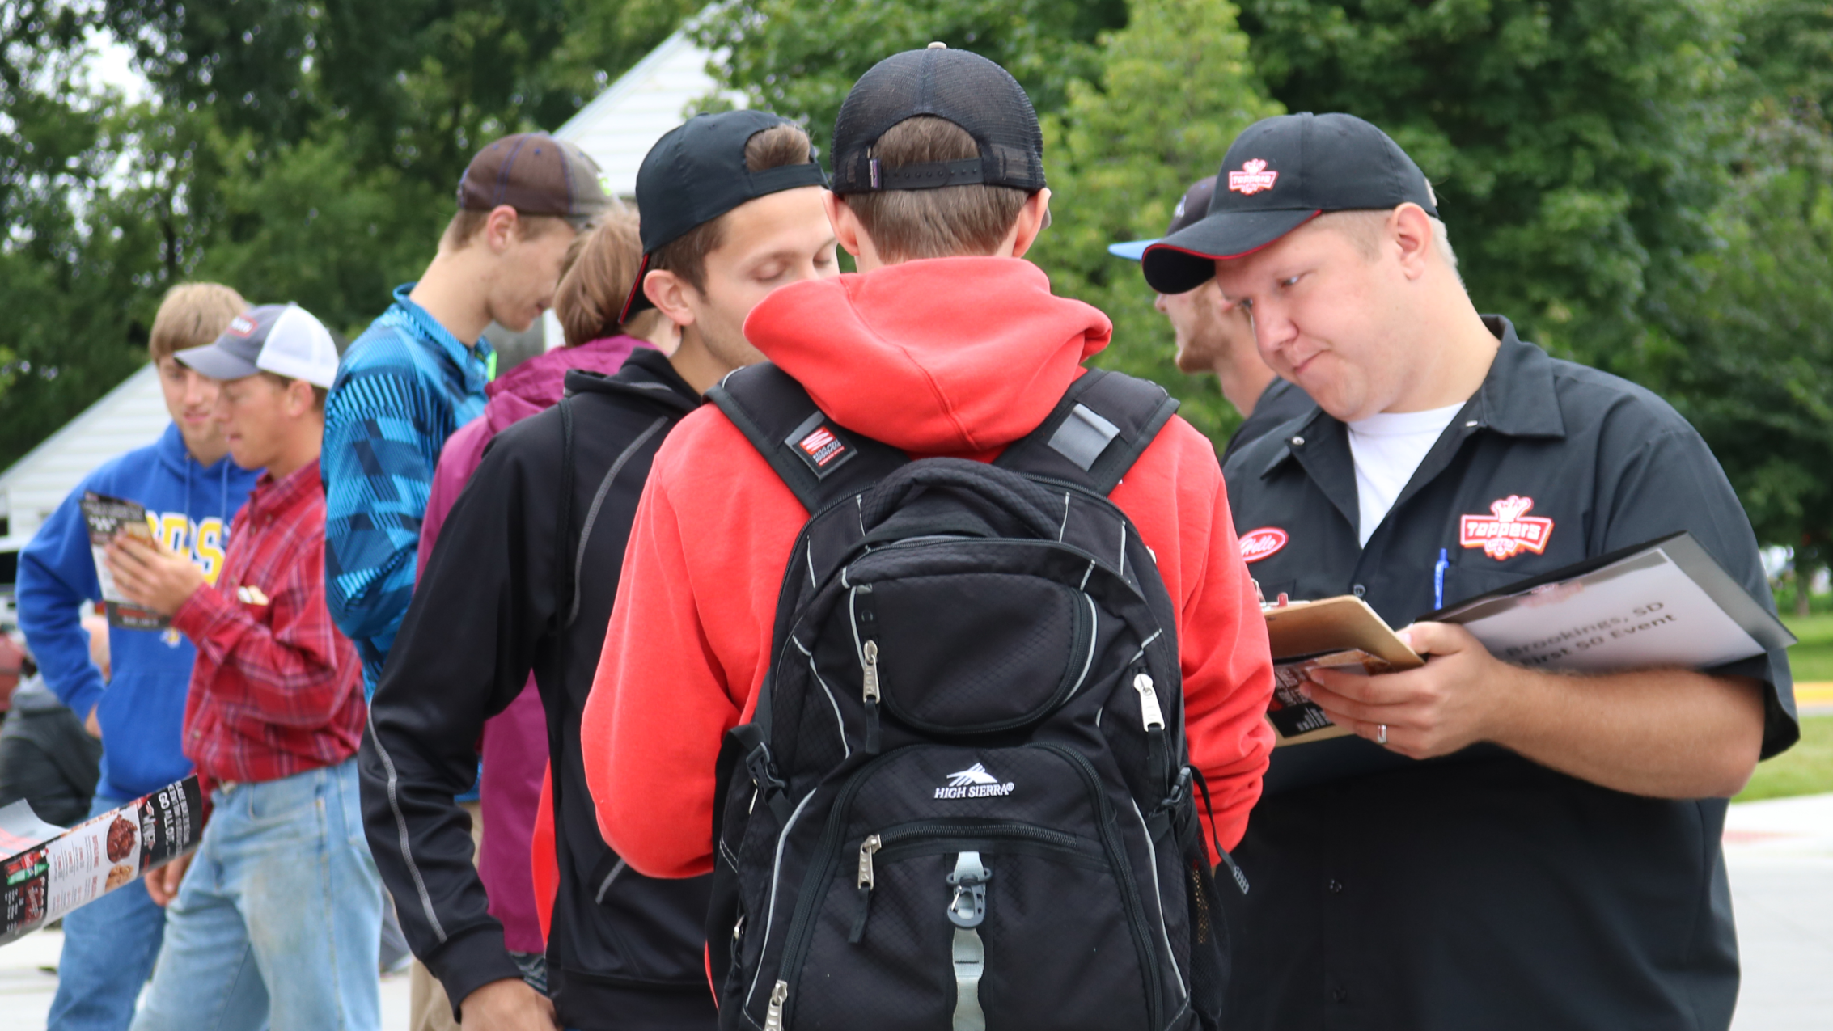
Get out there! Field Training
Notes:
Some general managers and even some franchisees aren’t very keen on going outside of the store and marketing. Not everyone is cut out for shaking hands and kissing babies, and that’s fine.
It’s important that the GM/Supervisor/Franchisee know this part well enough, that they can train it effectively to the Mad Dog. This helps the program run smoothly, even when there’s turnover.
However, if you feel like you need help training this piece, reach out to a member of the marketing team (marketing@toppers.com).

Slide 8
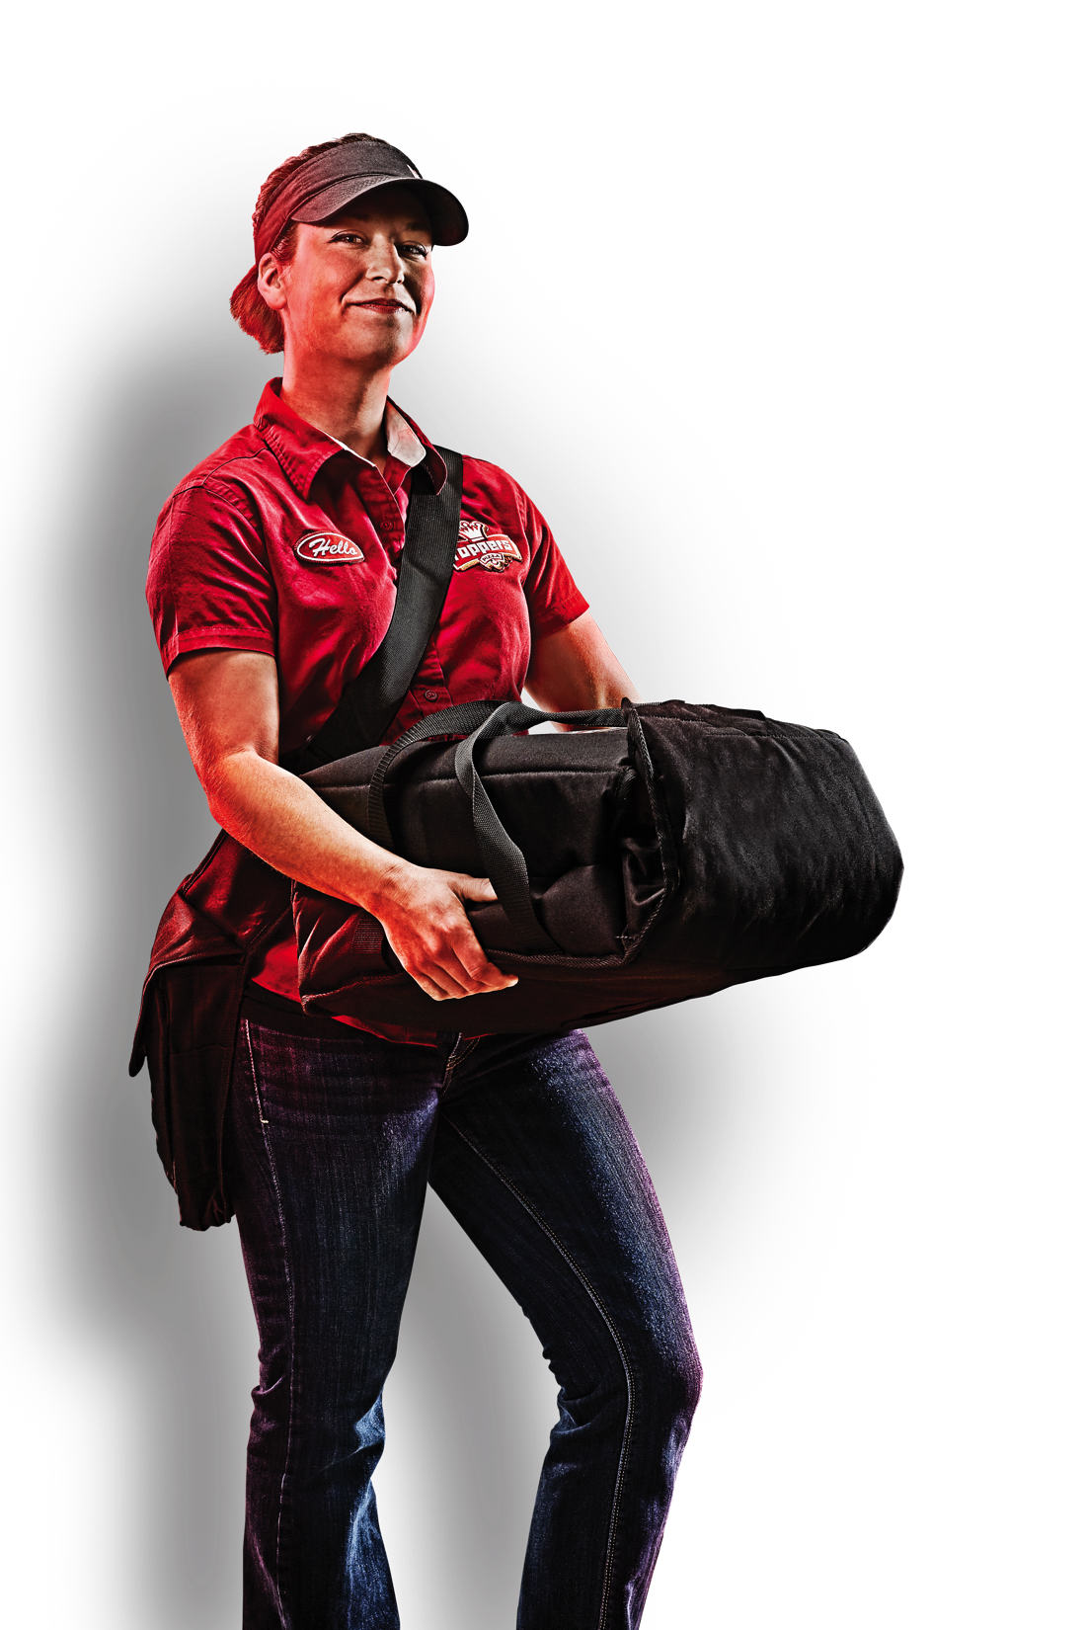
Field Training
At a Glance
1
One or two days- trainer leads first then Mad Dog leads with trainer’s feedback
2
Visit each type of business to practice elevator speech and recognize how to adjust pitch based on business type/opportunities
Schools- elementary and high
Large vs small businesses
Apartment leasing offices
Hotels
Retail
3
Follow up with contacts within 24 hours to recap what was discussed and provide them with program materials via email
Email template
Appropriate time for second follow up
Notes:
This is a sample of a field marketing agenda to use while training the Mad Dog.
Follow up point- Always ask for business cards/ contact information of decision makers

Slide 9
Accountability is key
LSM Checklist
Review
Involve Supervisors,
FBL’s, HQ Marketing
Share
wins!
2
4
6
1
3
5
Weekly Briefing
Adjust goals and
Targets accordingly
Possible
Bonus Plan
Notes:
The last piece of this puzzle is accountability. Which basically just means making sure that the plan gets done. This can take on many forms, and it’s recommended to choose what works best for you and your Mad Dog. The goal of this whole program is to be able to raise sales through local store marketing. So, weekly briefings and follow ups with your Mad Dog are very important for being able to adjust efforts that aren’t working and continue ramping up things that are working well. You want to be agile here. It will also give you an opportunity to asses the competency of the Mad Dog- meaning, if there’s consistently something that’s not being completed each week, you might need to reevaluate what this person should be doing. Or maybe you just need to back off on certain efforts if the store isn’t operating well at the moment.
It is also encouraged to involve supervisors, FBLs, and even the marketing folks at HQ in some of your emails between you and your Mad Dog if you’d like a little extra help encouraging them to complete tasks. This would also be a great place to share your Mad Dog’s LSM wins so they can see that they’re effectively building sales and that you’re stoked about it.
Another option is to create a bonus plan based on your Mad Dog’s achievements.

